Slide 1
UNIT II J2ME Best Practices and Patterns
Designing applications for small computing devices is a challenge, to say the least,primarily because of the limited resources found in these devices.
The small computing device contains minimal memory and storage room for persistent data.
Many traditional systems design methods and best practices are simply not appropriate for building applications to run on small computing devices

Slide 2
The Reality of Working in a J2ME World
Asmall computing device has a radically different hardware configuration than traditional computing devices such as desktop computers and servers.
Traditional computing devices are under Continuous power from the power grid, while some small computing devices such as cellular telephones rely on battery power that diminishes during the course of operation.
Apower grid powers other small computing devices such as set-top boxes and appliances.
Another important difference between traditional computing devices and small computing devices is the network connection

Slide 3
1.programs and data are stored in a small computer device’s memory, commonly referred to as primary storage.
These are lost when the device drops power, although many devices have a secondary battery to retain programs and data as long as possible.
2.Once lost, programs and data must be reloaded into the device. Secondary storage is not usually available on a small computing device.
3.Therefore, a J2ME application should rely on data stored offline in a desktop computer or server rather than data stored in the device’s primary storage.
4.Data stored offline can be reloaded into the device using a network connection.

Slide 4
5.Don’t expect a mobile small computing device to transmit and receive data at the same rate as a device on a hard-wired network.
6.Data transmission between a mobile small computing device and a traditional computing device is slow in comparison to a hard-wired network connection because radio and infrared technology offers a narrower transmission bandwidth than that found in hard-wired network connections.
7.A bandwidth is the number of communications channels available to transmit bits of data simultaneously.

Slide 5
Many users of your J2ME application expect the same response from your application as they experience from desktop computer applications. Therefore, you must design your J2ME application to minimize and optimize data transmission with offline data sources.
One way to optimize your J2ME application is called ROMizing the application for run-time operations.
ROMizing creates a machine code image of an application before the application is deployed on the small computing device

Slide 6
Best Practices
Over time and through trial and error, J2ME developers have come up with the best way
to solve complex J2ME programming problems. And these techniques are called BEST
PRACTICES AND PATTERNS.
Best practices are proven design and programming techniques used to build J2ME systems.
Patterns are routines that solve common programming problems that occur in such systems.
Professional developers use best practices and patterns to avoid making common mistakes when designing and building a J2ME application

Slide 7
Keep Applications Simple
Typically, you design an application by dividing it into objects that have associated DATA AND METHODS.
Let’s use an order form as an example.
An order form is an object that has an order number, customer number, product number,and related data.
Likewise, an order form has functionality associated with it, such as inserting a new order, modifying an existing order, and deleting an order.
And the order form has one or more menu options that enable a user to navigate the order form.

Slide 8
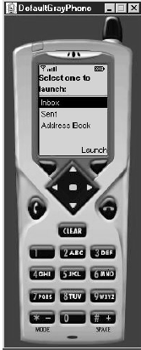
Keep Applications Small
The size of your J2ME application is critical to deploying the application efficiently. The best practice is to remove unnecessary components of your application in order to reduce the size of the overall application.

Slide 9
Limit the Use of Memory
In addition to removing unnecessary features from your application, design your application to manage memory efficiently.
There are two types of memory management that should be used in the J2ME application. These are overall memory management and peak time memory management.
Overall memory management is designed to reduce the total memory requirements of an application.
Peak memory management focuses on minimizing the amount of memory the application uses at times of increased memory usage on the device.

Slide 10
→A primary way to reduce total memory requirements of your application is to avoid using object types.
→Instead, use scalar types, which use less memory than object types.
→Likewise, always use the minimum data type suited for storing data.
→Peak time memory management requires you to manage garbage collection. J2ME does have a garbage collector, but as with J2SE, you don’t know when the garbage collector will collect your garbage.
Therefore, it is critical that you clean up after the application is finished using memory.

Slide 11
→Always reuse objects instead of creating new objects.
This reduces both memory allocation and the need for processing power.
Memory allocation is reduced because multiple references can use the same object at different times in the application’s life cycle.
Obviously, both objects that use the same memory cannot run simultaneously.
The need for processing power is reduced because a portion of the processing required to allocate new memory doesn’t need to be invoked since memory has already been allocated when the object is instantiated.

Slide 12
Off-Load Computations to the Server
Small computing devices are designed to run applications that do not require intensive processing because processing power common to desktop computers is not available onthese devices.
This means that you must design your J2ME application to perform minimal processing on the small computing device.
The alternative is to build a client-service J2ME application or web services J2ME application.
There are two levels of operation in a client-service application. These are the client level and the server level.
The small computing device runs the client level that provides user interface and presentation functionality to the application.
The server-side level processes client requests and returns the result to the small computing device for presentation to the user. Nearly all processing occurs on the server side of the application.

Slide 13
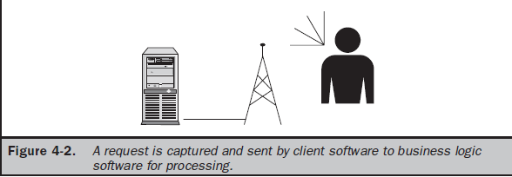
1.There are three tiers in web services.
2.The first layer is the client tier, sometimes referred to as the presentation tier. This is where a person interacts with an application.
3.The second layer contains the business logic that is used to fulfill requests from a client by calling appropriate software on the processing tier.
4.Processing software returns results to the business logic layer, and in turn, those results are returned to the client for presentation to the user.

Slide 14
Manage Your Application’s Use of a Network Connection
Besides lightening the processing load on the small computing device, you must also be concerned about the availability of a network connection.
Cellular telephone networks use technology that attempts to maintain connection as the mobile device moves from one cell to another cell. In reality there are dead zones where the mobile device is outside the range of the cellular telephone transceiver.
The drop in communication can occur without
warning, as many cellular telephone users have experienced.

Slide 15
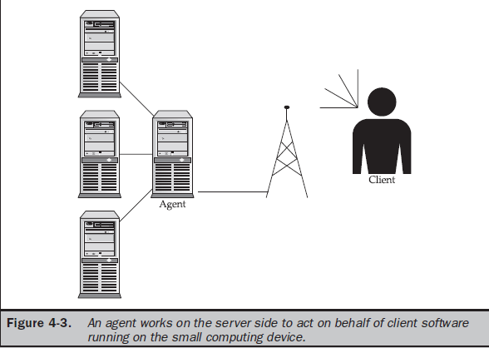
→Although you cannot avoid a break in communication, you can take steps to reduce the impact on the user of your application.
→Begin by keeping transmissions short—transfer the minimum information necessary to accomplish a task.
→Consider using store-forwarding technology and a server-side agent whenever your J2ME application requests a lot of information.
→A server-side agent is software running on the server that receives a request from a mobile device and then retrieves requested information from a data source, which is very similar to the business logic layer of web
services technology.

Slide 16
Simplify the User Interface
Most desktop applications have a standard set of graphical user interface objects such as text boxes, combo boxes, radio buttons, check boxes, and push buttons.
However, small computing devices use a variety
of user display and input devices. Some devices, such as a cellular telephone, have an inch-square display and a telephone keypad for data input.
There is a standard display and input for desktop computers, but you cannot say the same about small computing devices.
The variety of shapes and hardware configurations found in devices classified as small computing devices makes it nearly impossible to standardize on a set of user interface objects for these devices.

Slide 17
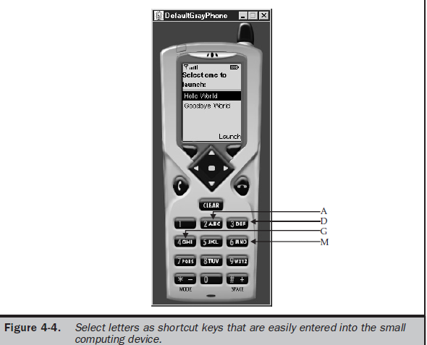
It is critical that you design a user interface that takes advantage of convenient features found on a small computing device and avoid user interactions that are awkward to perform.
If you decide to create a user interface containing a menu, consider the available input mechanisms of the small computer device before beginning your design.
Some devices have touch screens that enable you to use icons, rather than words, to represent menu options. Other devices, such as cellular telephones, have limited keypads.
Let’s say three options are presented in a list on the screen. Typically,
you identify each option with a shortcut key that is a sequence of letters (A, B, C), or numbers (1, 2, 3), or a letter within the name of the option.

Slide 18
Use Local Variables
Limited resource is the theme that echoes through design considerations for applications that run on small computing devices.
As a developer, you cannot assume there are sufficient resources on every small computing device to run your application.
You’ll find this line of thought radically different from the mind-set used to write applications for desktop devices and server devices, where you can safely assume that sufficient resources exist to run an application.
Data storage is a key area within an application for reducing excessive processing.
In many applications, developers assign values to data members of a class rather than using a local variable.
You can increase processing of your application if you eliminate the extra steps of accessing a data member of a class by assigning values to local variables.

Slide 19
Don’t Concatenate Strings
Concatenating strings is another processing drain that can be avoided by designing an application to eliminate concatenations or at least reduce the number of concatenations to the minimum necessary to achieve the objective of the application.

Slide 20
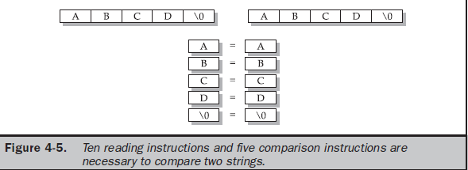
A string is an array of characters terminated by a NULL and stored sequentially in memory. Let’s assume the application wants to compare two strings, both of which are four characters and reside in memory. The application instructs the small computing device to copy the first character of each string into the CPU for comparison. This process continues until either the null character is reached or a letter pair is different. The entire
process might require ten reading instructions and five comparison instructions, depending on when a mismatch is discovered

Slide 21
Avoid Synchronization
It is very common for developers to invoke one or multiple threads within an operation.
Invoking a thread is a way of sharing a routine among other operations. For example,
a sort routine can be shared simultaneously by multiple operations that must sort data.
Each operation invokes the sort routine independent of other operations, although the same code is being executed for all operations.

Slide 22
Deadlocks and other conflicts might arise when multiple operations use the same routine.
These problems are avoided by synchronizing the invocations of a thread, as you probably remember when you learned Java programming.
Always use a thread whenever an operation takes longer than a tenth of a second to run because a thread requires less overhead than non-thread invocation methods, and
therefore you’ll see a performance increase in your application.

Slide 23
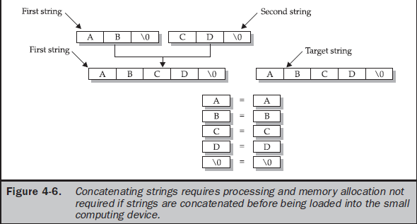

Slide 24
Thread Group Class Workaround
A common way of reducing the overhead of starting a new thread is to create a group of thread objects that are assigned threads as needed by operations within an application.
Less processing is required to assign a thread to an existing thread object than to create a new thread object.
Grouping thread objects is made possible by the ThreadGroup class, but J2ME does not support this class.
You can work around it, however, by creating your own grouping using the Collection class. You can store groups of thread objects in a collection and then
use standard collection methods to start and stop threads in the collection and assign threads to particular thread objects within the collection.

Slide 25
Upload Code from the Web Server
Version management is always a concern of application developers, especially when applications are invoked from within a small computing device.
You can reduce and possibly eliminate problems associated with multiple versions of the same application by requiring invocation of the application from a web server.
Here’s how a small computing device can invoke a web server–based J2ME application:
midp -transient http://www.mycompany.com/welcome.jad
Rather than running a local JAD file, the -transient option specifies that the JAD file is located on a web server identified by the URL on the command line. In this way, the developer only needs to update one copy of the application, and distribution is handled by making the latest version of the application available on the web server.

Slide 26
Reading Settings from JAD Files
There will likely be occasions when you need to have your application perform in a certain way, depending on the type of small computing device that runs the application.
First, design your application with switches that activate and/or deactivate routines depending on the value of a setting. A setting is a value assigned to a variable that is either created within the application or passed to the application as a command line parameter.
J2ME applications are capable of reading the value of a setting from a JAD file and manifest file.

Slide 27
→It shows a typical JAD file that includes a user-defined value called Model- Version: M253.
→The J2ME program in Listing 4-2 illustrates how to read this user-defined value during run time without having to recompile or repackage the application.
→A user-defined value is read by invoking the getAppProperty() method and passing the name of the user-defined value to the getAppProperty() method.
→The getAppProperty() returns the user-defined value from either the manifest file or the JAD file depending on which of these files contains the user-defined value.
→Model-Version user-defined value defined in the JAD file and displays the value on the screen.
→Of course, you can create a compound statement that invokes the getAppProperty() method and then assigns the returned value to a variable or uses the return value directly in an expression.

Slide 28
MIDlet-Name: Best MIDlet
MIDlet-Version: 2.0
MIDlet-Vendor: MyCompany
MIDlet-Jar-URL: http://www.mycompany.com/bestmidlet.jar
MIDlet-1: BestMIDlet, /images/BestMIDlet.png, Best.BestMIDlet
Model-Version: M253
public class BasicMIDletShell extends MIDlet
{
public void startApp()
{
System.out.println(getAppProperty("Model-Version"));
}
public void pauseApp()
{
}
public void destroyApp( boolean unconditional)
{
}
}

Slide 29
Populating Drop-down Boxes
A drop-down box is a convenient way for users to choose an item from a list of possible items, such as an abbreviation for a state. Traditionally, content of a drop-down box is loaded from the data source once when the application is invoked and remains in memory until the application terminates.
While caching the contents in memory is a best practice in Java programming, caching is a questionable practice when developing a J2ME application.
Loading a list of data for a drop-down box when the J2ME application is invoked is efficient if this is a short list that doesn’t require substantial memory resources.
Load the list dynamically from a server whenever the list is long. Release the list once the user has made a selection, and then reload the list the next time the drop-down box
is invoked.
In this way, memory used to store the list can be reused between calls to the drop-down box.

Slide 30
Commands, Items, and Event Processing
Nearly every J2ME application has an interface that enables user interactions with the application.
The user interface can be as simple as pressing a button on the small computing device, which causes the application to react, or as complex as
displaying a form containing check boxes, radio buttons, lists, and other objects common to many applications.
Selections made by a user are considered events that are forwarded to your application by the device’s application manager for processing.
The application’s developer must write code that recognizes an event and then reacts to the event by performing a task based on the nature of the application.

Slide 31
J2ME User Interfaces
A user interface is a set of routines that displays information on the screen, prompts the user to perform a task, and then processes the task.
For example, a J2ME email application might display a list of menu options, such as Inbox, Compose, and Exit, and then prompt the user to make a selection by moving the cursor keys and pressing a key on the small computing device.
The device’s application manager passes the selection to the application, where it is compared with known options.
If a match occurs, the application performs
the steps necessary to process the option.
A developer can use one of three kinds of user interfaces for an application.
These are a command, form, or canvas.

Slide 32
→A command-based user interface consists of instances of the Command class. An instance of the Command class is a button that the user presses on the device to enact a specific task.
→For example, Exit is an instance of the Command class associated with an Exit button on the keypad to terminate the application.
→The Help button is also an instance of the Command class that is linked to the Help key on the device, which is used whenever the user requires assistance.
→A form-based user interface consists of an instance of the Form class that contains instances derived from the Item class such as text boxes, radio buttons, check boxes, lists, and other conventions used to display information on the screen and to collect input from the user. A form is similar to an HTML form.
→A canvas-based user interface consists of instances of the Canvas class within which the developer creates images such as those used in a game.

Slide 33
Display Class
The device’s screen is referred to as the display, and you interact with the display by obtaining a reference to an instance of the MIDlet’s Display class.
Each MIDlet has one and only one instance of the Display class. Every J2ME MIDlet that displays anything on the screen must obtain a reference to its Display instance.
This instance is used to show instances of Displayable class on the screen.
The Displayable class has two subclasses. These are the Screen class and the Canvas class.
The Screen class contains a subclass called the Item class, which has its own subclasses used to display information or collect information from a user (such as forms, check boxes, radio buttons). The Screen class and its derived classes are referred to as high-level user interface components.
The Canvas class is used to display graphical images such as those used for games.
Displays created using the Canvas class are considered a low-level user interface and are used whenever you need to display a customized screen.

Slide 34
→Instances of classes derived from the Displayable class are placed on the screen by calling the setCurrent() method of the Display class.
→The object that is to be displayed is passed to the setCurrent() method as a parameter. It is important to note that instances of derived classes of the Item class are not directly displayable and must be contained within an instance of a Form class.
→ An instance of an Item class appears on the screen when the setCurrent() method is used to show the form.
→The getCurrent() method of the Display class is used by a MIDlet to retrieve information about the instances of derivatives of the Displayable class.

Slide 36
Multiple calls to the getDisplay(this) method
return the same Display instance.
private Display display;
display = Display.getDisplay(this);

Slide 37
→Listing 5-1 contains the JAD file for this MIDlet, and →Listing 5-2 illustrates how the Display class is used to determine the color attribute of the small computing device’s screen.
→In this example, the MIDlet invokes the isColor() method of the Display class to determine whether the screen is capable of displaying color.
→If so, the MIDlet displays an instance of the TextBox class reporting that the device has a color screen; otherwise the instance reports that the device is incapable of displaying color.
→Of course, in a realworld MIDlet, the response returned by the isColor() method is used within the MIDlet either to activate or deactivate routines that manipulate color on the screen.

Slide 38
MIDlet-Name: CheckColor
MIDlet-Version: 1.0
MIDlet-Vendor: MyCompany
MIDlet-Jar-URL: CheckColor.jar
MIDlet-1: CheckColor, CheckColor.png, CheckColor
MicroEdition-Configuration: CLDC-1.0
MicroEdition-Profile: MIDP-1.0
MIDlet-JAR-SIZE: 100
import javax.microedition.midlet.*;
import javax.microedition.lcdui.*;
public class CheckColor extends MIDlet implements CommandListener
private Display display;
private Form form;
private TextBox textbox;
private Command exit;
public CheckColor()
{
display = Display.getDisplay(this);
exit = new Command("Exit", Command.SCREEN, 1);
String message=null;
if (display.isColor())

Slide 39
{
message="Color display.";
} else
{ message="No color display";
}
textbox = new TextBox("Check Colors", message, 17, 0);
textbox.addCommand(exit);
textbox.setCommandListener(this);
} public void startApp()
{ display.setCurrent(textbox);
}
public void pauseApp()
{
}
public void destroyApp(boolean unconditional)
{ }
public void commandAction(Command command,
Displayable displayable)
{
if (command == exit)
{
destroyApp(true);
notifyDestroyed();
} } }

Slide 40
Command Class
You create an instance of the Command class by using the Command class constructor within your J2ME application. The Command class constructor requires three parameters.
These are the command label, the command type, and the command priority.
The Command class constructor returns an instance of the Command class.
The following example illustrates a cancel command. The first parameter of the command declaration is Cancel.
cancel = new Command("Cancel", Command.CANCEL, 1);

Slide 41
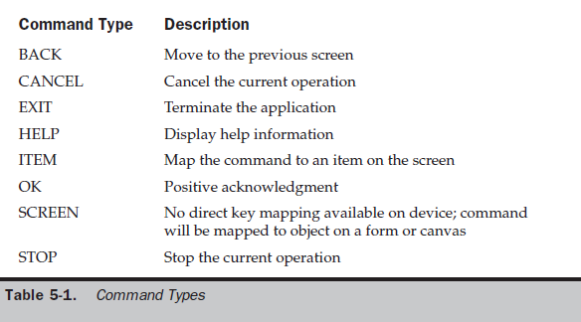

Slide 42
Command Listener
Every J2ME application that creates an instance of the Command class must also create an instance that implements the CommandListener interface. The CommandListener is notified whenever the user interacts with a command by way of the commandAction() method. Classes that implement the CommandListener must implement the commandAction() method, which accepts two parameters.
The first parameter is a reference to an instance of the Command class, and the other parameter is a reference to the instance of the Displayable class, as
public void commandAction(Command command, Displayable displayable)
{ if (command == cancel)
{
destroyApp(false);
notifyDestroyed();
} }
The device’s application manager calls the commandAction() method and passes the command selected by the user. You must evaluate the command to determine the command selected by the user. An if statement is used in this example to evaluate the command.

Slide 43
Online Help Example

Slide 44
1..The user returns to the previous screen by selecting the Back command .
2..The Back command removes the Help text box from the screen and returns the user to the original screen. 3..The last command that is found in all J2ME applications is the Exit command.
4..The Exit command terminates the application.
MIDlet-Name: OnlineHelp
MIDlet-Version: 1.0
MIDlet-Vendor: MyCompany
MIDlet-Jar-URL: OnlineHelp.jar
MIDlet-1: OnlineHelp, , OnlineHelp
MicroEdition-Configuration: CLDC-1.0
MicroEdition-Profile: MIDP-1.0
MIDlet-JAR-SIZE: 100

Slide 45
import javax.microedition.midlet.*;
import javax.microedition.lcdui.*;
public class OnlineHelp extends MIDlet implements CommandListener
{
private Display display;
private Command back;
private Command exit;
private Command help;
private Form form;
private TextBox helpMesg;
public OnlineHelp()
{
display = Display.getDisplay(this);
back = new Command("Back", Command.BACK, 2);
exit = new Command("Exit", Command.EXIT, 1);
help = new Command("Help", Command.HELP, 3);

Slide 46
form = new Form("Online Help Example");
helpMesg = new TextBox("Online Help", "Press Back to return
to the previous screen or press Exit to close this
program.", 81, 0);
helpMesg.addCommand(back);
form.addCommand(exit);
form.addCommand(help);
form.setCommandListener(this);
helpMesg.setCommandListener(this);
}
public void startApp()
{
display.setCurrent(form);
}
public void pauseApp()
{ }

Slide 47
public void destroyApp(boolean unconditional)
{
}
public void commandAction(Command command,
Displayable displayable)
{
if (command == back)
{
display.setCurrent(form);
}
else if (command == exit)
{
destroyApp(false);
notifyDestroyed();
}
else if (command == help)
{
display.setCurrent(helpMesg);
}
}
}

Slide 48
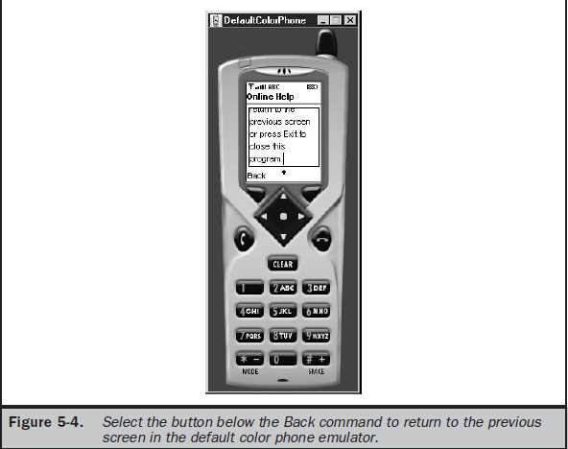

Slide 49
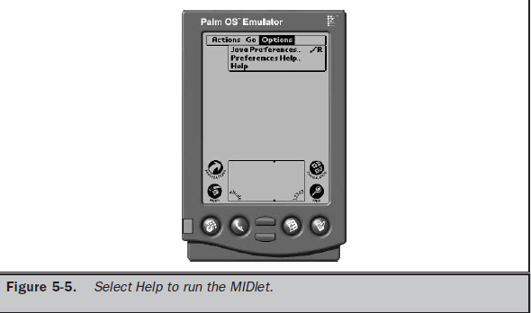

Slide 50
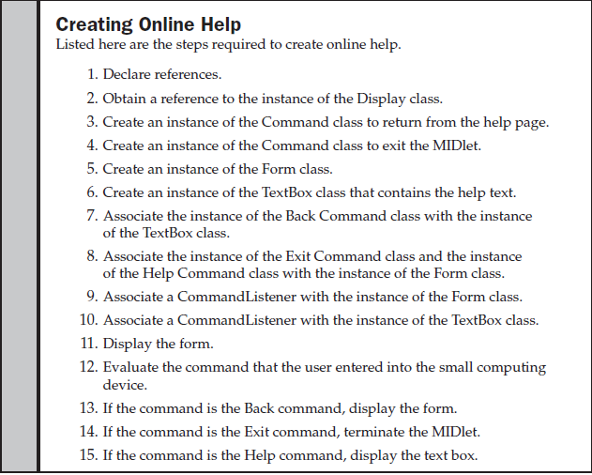

Slide 51
Item Class
The Item class is derived from the Form class, and that gives an instance of the Form class character and functionality by implementing text fields, images, date fields, radio buttons, check boxes, and other features common to most graphical user interfaces.
The Item class has derivative classes that create those features.
In many ways, the Item class has similarities to the Command class in that instances of both classes must be declared and then added to the form. Likewise, a listener processes instances of both the Item class and the Command class.

Slide 52
1..For example, your application might present options in the form of an instance of the ChoiceGroup class, which is derived from the Item class.
2..An instance of a ChoiceGroup class is a check box or radio button.
The user makes a selection by choosing a check box or radio button.
3..A change in the status of an instance of the Item class is processed by the itemStateChanged() method.
4..The itemStateChanged() method is similar to the actionCommand() method used to respond to the invocation of a command by the user of your application.
5..Although these methods are similar in design, you cannot combine them into one method because the application manager specifically calls the itemStateChanged() method and actionCommand() method independently of each other.

Slide 53
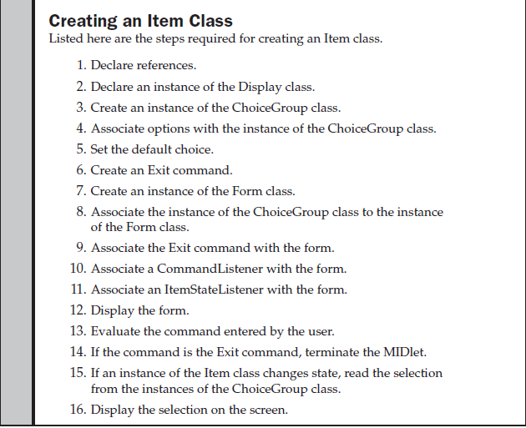

Slide 54
Item Listener
Each MIDlet that utilizes instances of the Item class within a form must have an itemStateChanged() method to handle state changes in these instances.
public void itemStateChanged(Item item)
{
if (item == selection)
{
StringItem msg = new StringItem("Your color is ",
radioButtons.getString(radioButtons.getSelectedIndex()));
form.append(msg);
}

Slide 55
MIDlet-Name: RadioButtons
MIDlet-Version: 1.0
MIDlet-Vendor: MyCompany
MIDlet-Jar-URL: RadioButtons.jar
MIDlet-1: RadioButtons, , RadioButtons
MicroEdition-Configuration: CLDC-1.0
MicroEdition-Profile: MIDP-1.0
MIDlet-JAR-SIZE: 100
import javax.microedition.midlet.*;
import javax.microedition.lcdui.*;
public class RadioButtons extends MIDlet
implements ItemStateListener, CommandListener
{
private Display display;
private Form form;
private Command exit;
private Item selection;
private ChoiceGroup radioButtons;
private int defaultIndex;
private int radioButtonsIndex;
public RadioButtons()
{

Slide 56
public void pauseApp()
{
}
public void destroyApp(boolean unconditional)
{
}
public void commandAction(Command command,
Displayable displayable)
{
if (command == exit)
{
destroyApp(true);
notifyDestroyed();
}
}
public void itemStateChanged(Item item)
{
if (item == radioButtons)
{
StringItem msg = new StringItem(Your color is ",
radioButtons.getString(radioButtons.getSelectedIndex()));
form.append(msg);
}
}
}

Slide 57
An instance of the ChoiceGroup class is created next. The instance has a title called “Select Your Color” and a type, which in this example is EXCLUSIVE.
As you’ll learn in Chapter 6, the type of an instance of the ChoiceGroup class determines its display and functionality.
The EXCLUSIVE type causes the instance to appear and function as a set of radio buttons.
The MULTIPLE type transforms the instance into check boxes.

Slide 58
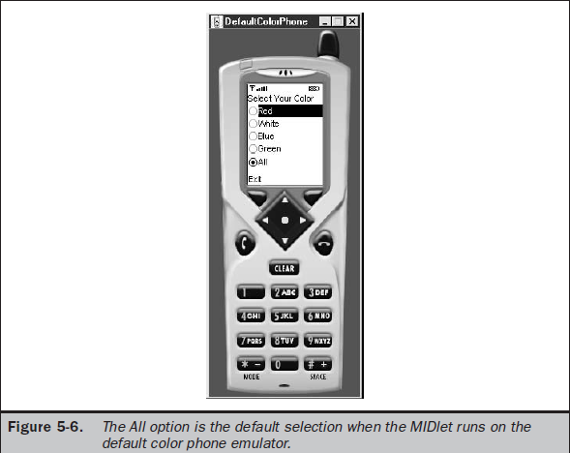

Slide 59
display = Display.getDisplay(this);
radioButtons = new ChoiceGroup(
"Select Your Color",
Choice.EXCLUSIVE);
radioButtons.append("Red", null);
radioButtons.append("White", null);
radioButtons.append("Blue", null);
radioButtons.append("Green", null);
defaultIndex = radioButtons.append("All", null);
radioButtons.setSelectedIndex(defaultIndex, true);
exit = new Command("Exit", Command.EXIT, 1);
form = new Form("");
radioButtonsIndex = form.append(radioButtons);
form.addCommand(exit);
form.setCommandListener(this);
form.setItemStateListener(this);
}
public void startApp()
{
display.setCurrent(form);
}

Slide 60
Exception Handling
The small computing device’s application manager oversees the operation of a MIDlet.
The application manager calls the startApp(), pauseApp(), and destroyApp() methods whenever the user or the device requires a MIDlet to begin,
pause, or terminate.
You can regain a little control of the MIDlet’s operation by causing a MIDletStateChangeException to be thrown. MIDletStateChangeException is usedto temporarily reject a request from the application manager either to start the MIDlet (startApp()) or to destroy the MIDlet (destroyApp()).
AMIDletStateChangeException cannot be thrown within the pauseApp() method.

Slide 61
You should incorporate routines that throw a MIDletStateChangeException whenever your MIDlet has processing that should not be interrupted by the application manager.
Many developers place routines that throw a MIDletStateChangeException in the
destroyApp() method since terminating a MIDlet during critical processing might have a fatal effect on communication or data.

Slide 62
Throwing a MIDletStateChangeException
MIDlet-Name: ThrowException
MIDlet-Version: 1.0
MIDlet-Vendor: MyCompany
MIDlet-Jar-URL: ThrowException.jar
MIDlet-1: ThrowException, ThrowException.png, ThrowException
MicroEdition-Configuration: CLDC-1.0
MicroEdition-Profile: MIDP-1.0
MIDlet-JAR-SIZE: 100
import javax.microedition.midlet.*;
import javax.microedition.lcdui.*;
public class ThrowException extends MIDlet
implements CommandListener
{
private Display display;
private Form form;
private Command exit;
private boolean isSafeToQuit;
public ThrowException()

Slide 63
{
isSafeToQuit = false;
display = Display.getDisplay(this);
exit = new Command("Exit", Command.SCREEN, 1);
form = new Form("Throw Exception");
form.addCommand(exit);
form.setCommandListener(this);
}
public void startApp()
{
display.setCurrent(form);
}
public void pauseApp()
{
}
public void destroyApp(boolean unconditional)
throws MIDletStateChangeException
{
if (unconditional == false)
{
throw new MIDletStateChangeException();
}
}

Slide 64
public void commandAction(Command command,
Displayable displayable)
{
if (command == exit)
{
try
{
if (exitFlag == false)
{
StringItem msg = new StringItem (
"Busy", "Please try again.");
form.append(msg);
destroyApp(false);
}
else
{
destroyApp(true);
notifyDestroyed();
}
}
catch (MIDletStateChangeException exception)
{
isSafeToQuit = true;
} } } }

Slide 65
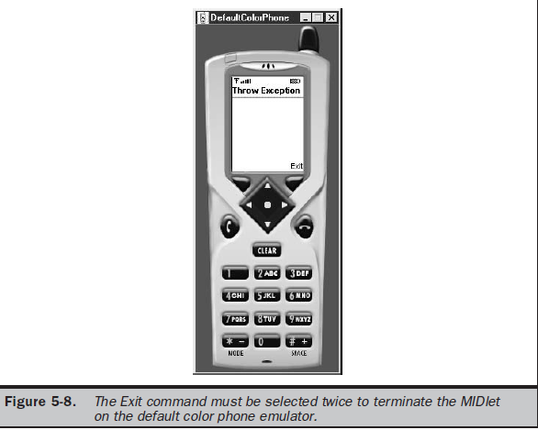

Slide 66
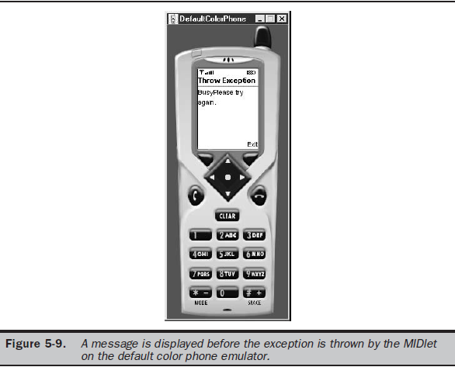

Slide 67
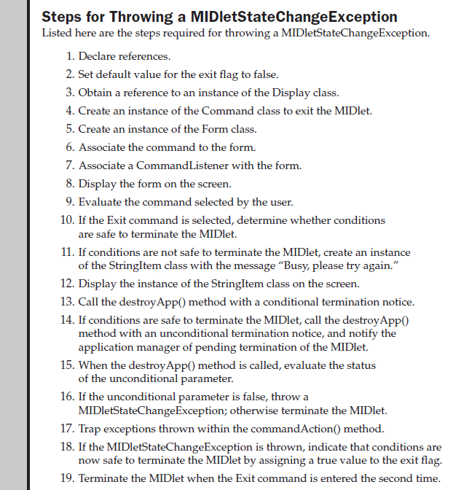

Slide 68
High-Level Display: Screens
High-Level Display Screens:
1.Screen Class
2.Alert Class
3.Form Class
4.Item Class
5.List Class
6. Text Box Class
7.Ticker Class

Slide 69
→The display is a crucial component of every J2ME application since it contains objects used to present information to the person using the application and in many cases prompts the person to enter information that is processed by the application.
→The J2ME Display class is the parent of Displayable, which you’ll recall from the previous chapter.
→The Displayable class has two subclasses of its own: Screen
and Canvas.
→The Screen class is used to create high-level J2ME displays in which the methods of its subclasses handle details of drawing objects such as radio buttons and check boxes.
→In contrast, the Canvas class and its subclasses are used to create low-level J2ME displays.
→The methods give you pixel-level control of the display, enabling you to draw your own images and text such as those used to create games.

Slide 70
Screen Class
You will probably spend most of your time using the Screen class and its derived classes when developing a user interface for your J2ME application.
These classes contain methods that generate radio buttons, check boxes, lists, and other familiar objects that users expect to find on the screen when interacting with your application.
The following illustrates the Display class hierarchy, which helps you learn the inheritance structure of the Screen class.
Every MIDlet has one Display object but can have many Displayable objects, which you discovered in the previous chapter.
A Displayable object is any object that can be displayed
on the small computing device’s screen.

Slide 71
public class Display
public abstract class Displayable
public abstract class Screen extends Displayable
public class Alert extends Screen
public class Form extends Screen
public class List extends Screen implements Choice
public abstract class Item
public class ChoiceGroup extends Item implements Choice
public class DateField extends Item
public class TextField extends Item
public class Gauge extends Item
public class ImageItem extends Item
public class StringItem extends Item
public class TextBox extends Screen
public class Command
public class Ticker
public class Graphics
public interface Choice
public abstract class Canvas extends Displayable
public class Graphics

Slide 72
You already know that the Displayable class has two derived classes, Screen and Canvas.
The Screen class has its own set of derived classes. These are TextBox, List, Alert, Form, and Item classes.
The Canvas class also has its own derived class, the Graphics class, which you’ll learn about in the next chapter.
The TextBox class is used to display multi-line text on the screen.
The List class is used to display a list of items, as in a menu, and enables the user to choose one of those items.
The Alert class displays a dialog box containing a message such as a warning.
And the Form class is a container class that can display multiple classes derived from the Item class.

Slide 73
1.The Item class has six derived classes, any number of which can be displayed within a Form object on the screen:
■ ChoiceGroup class used to display radio buttons and check boxes
■ DateField class used for inputting a date into an application
■ TextField class used for inputting text into an application
■ Gauge class used to graphically show progress
■ ImageItem class used to display an image stored in a file
■ StringItem class used to display text on the screen

Slide 74
2.The Command class is used to create a Command object that can be associated with practically any class except the Alert class.
3.You created Command objects for MIDlets that you built in the previous chapter.
4.The Ticker is a variable of the Screen class that causes text to scroll on the screen like a stock exchange ticker tape.
5.The Graphics class is a base class used by derived classes to create and display custom graphical images on the screen.

Slide 75
Alert Class
An alert is a dialog box displayed by your program to warn a user of a potential error such as a break in communication with a remote computer.
An alert can also be used to display any kind of message on the screen, even if the message is not related to an error.
For example, an alert is an ideal way of displaying a reminder on the screen. You implement an alert by creating an instance of the Alert class in your program using the following statement.
Once created, the instance is passed to the setCurrent() method of the Display object to display the alert dialog box on the screen.
alert = new Alert("Failure", "Lost communication link!", null, null);
display.setCurrent(alert);

Slide 76
→The Alert constructor requires four parameters.
The first parameter is the title of the dialog box, which is “Failure” in this example.
The next parameter is the text of the message displayed within the dialog box. “Lost communication link!” is the text that appears when the Failure dialog box is shown on the screen.
→The third parameter is the image that appears within the dialog box. →The previous example doesn’t use an image; therefore the third parameter is set to null.
→The last parameter is the AlertType.
→The AlertType is a predefined type of alert. None of the predefined AlertTypes is used in the previous example, and therefore a null is used as the fourth parameter

Slide 77
→An alert dialog box is not designed to retrieve input from a user other than the selection of the OK button to close the dialog box.
→This means displayable objects such as ChoiceGroup and TextBox cannot be used within an alert dialog box.
→Likewise, you cannot insert your own Command objects as buttons.
An alert dialog box reacts in one of two ways depending on the value of the default timeout for the Alert object.
→The alert dialog box can remain visible until the user selects the
OK button, or the alert dialog box can be visible for a specified number of milliseconds.
→An alert dialog box is referred to as a modal dialog box if the user must select the OK button to terminate the dialog box.
→ Otherwise, it is considered a timed dialog box that terminates
when the default timeout value is reached.

Slide 78
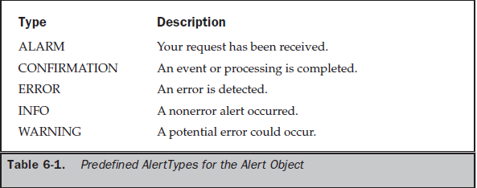

Slide 79
alert = new Alert("Failure", "Lost communication link!", null, null);
alert.setTimeout(Alert.FOREVER);
display.setCurrent(alert);
→You can always retrieve the current default timeout by calling the getDefaultTimeout() method of the instance of the Alert class.
→The getDefaultTimeout() method returns the integer value of Alert.
→FOREVER or the default timeout in milliseconds.

Slide 80
→The device’s application manager determines the screen that appears when the user dismisses the alert dialog box.
→However, you can control what appears following the dialog box by passing reference to the next object as the second parameter to the
setCurrent() method.
→The second parameter is reference to the displayable object that appears on the screen once the alert dialog box is closed.

Slide 81
→The instance of the Form class contains instances of classes necessary to open a communications link with a remote computer.
→In this example, the instance of the Form class is titled “Communications Link.”
→Notice that instances of both the Alert class and the Form class are passed to the setCurrent() method.
→Once the user selects OK to dismiss the alert dialog box, the device’s application manager displays the instances of the Form object, enabling the user to reestablish communication with the remote computer.
form = new Form("Communication Link");
alert = new Alert("Failure", "Lost communication link!", null, null);
alert.setTimeout(Alert.FOREVER);
display.setCurrent(alert, form);

Slide 82
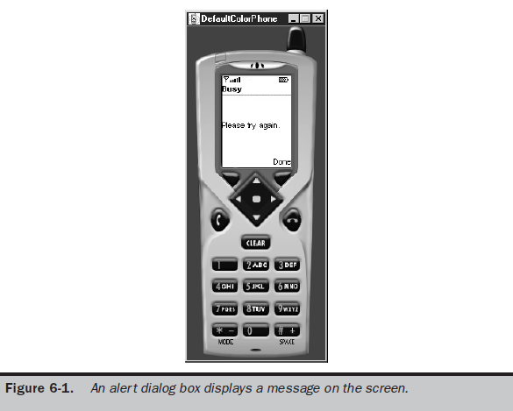

Slide 83
MIDlet-Name: DisplayAlert
MIDlet-Version: 1.0
MIDlet-Vendor: MyCompany
MIDlet-Jar-URL: DisplayAlert.jar
MIDlet-1: DisplayAlert, , DisplayAlert
MicroEdition-Configuration: CLDC-1.0
MicroEdition-Profile: MIDP-1.0
MIDlet-JAR-SIZE: 100
import javax.microedition.midlet.*;
import javax.microedition.lcdui.*;
public class DisplayAlert extends MIDlet implements CommandListener
{ private Display display;
private Alert alert;
private Form form;
private Command exit;
private boolean exitFlag;
public DisplayAlert()

Slide 84
{
exitFlag = false;
display = Display.getDisplay(this);
exit = new Command("Exit", Command.SCREEN, 1);
form = new Form("Throw Exception");
form.addCommand(exit);
form.setCommandListener(this);
}
public void startApp()
{
display.setCurrent(form);
}
public void pauseApp()
{
ception is
thrown
}
public void destroyApp(boolean unconditional)
throws MIDletStateChangeException
{
if (unconditional == false)
{
throw new MIDletStateChangeException();
} }

Slide 85
public void commandAction(Command command, Displayable displayable)
{
if (command == exit)
{
try
{
if (exitFlag == false)
{
alert = new Alert("Busy", "Please try again.",
null, AlertType.WARNING);
alert.setTimeout(Alert.FOREVER);
display.setCurrent(alert, form);
destroyApp(false);
}
else
{
destroyApp(true);
notifyDestroyed();
}
}
catch (MIDletStateChangeException exception)
{
exitFlag = true;
} } } }

Slide 86
Alert Sound
Each AlertType has an associated sound that automatically plays whenever the alert dialog box appears on the screen.
The sound, which is different for each AlertType, is used as an audio cue to indicate that an event is about to occur.
Users of your MIDlet will learn to identify events by sound cue over time and will become less dependent on the visual cue presented by the alert dialog box.
An audio cue can be sounded without having to display the alert dialog box. You do this by calling the playSound() method and passing it reference to the instance of the Display class, as illustrated in the following code segment. This is a modification of the if statement in Listing 6-1. The sound associated with the AlertType WARNING is heard when the playSound() method is called.
if (exitFlag == false)
{
AlertType.WARNING.playSound(display);
destroyApp(false); }

Slide 87
Form Class
The Form class is a container for other displayable objects that appear on the screen simultaneously. Any derived class of the Item class can be placed within an instance of the Form class.
For example, instances of the StringItem class can be displayed by inserting those instances within the instance of the Form class, then showing the
instance of the Form class.

Slide 88
Small computing device screens vary in size, so you can expect that some instances within the instance of the Form class won’t fit on the screen.
However, devices typically implement scrolling, which allows the user to bring instances out of view onto the screen.
An instance is placed with the instance of the Form class by calling one of two methods.
These are insert() method and append() method. The insert() method places the instance in a particular position on the form as specified by parameters passed to the insert() method.
The append() method places the instance after the last object on the form.
private Form form;
private StringItem message;
form = new Form("My Form");
message = new StringItem("Welcome, ", "glad you could come.");
form.append(message);

Slide 89
→Each instance placed on a form has an index number associated with it, beginning with the value zero.
→You can use the index number to reference the instance within your MIDlet, for example, when you want to insert an instance onto the form.
private Form form;
private StringItem message1, message2;
private int index1;
form = new Form("My Form");
message1 = new StringItem("Welcome, ", "glad you could come.");
message2 = new StringItem("Hello, ", "Mary.");
index1 = form.append(message1);
form.insert(index1,message2);

Slide 90
An alternative to using the insert() and append() methods for associating instances of the Item class with a form is to create an array of instances of the Item class and then pass the array to the constructor when the instance of the Form class is created. This is an excellent technique for initially populating the instance of the Form class. You can then use the insert() method, append() method, set() method, and delete() method to manage instances of the Item object on the form throughout the life of the MIDlet.
MIDlet-Name: CreatingFormWithItems
MIDlet-Version: 1.0
MIDlet-Vendor: MyCompany
MIDlet-Jar-URL: CreatingFormWithItems.jar
MIDlet-1: CreatingFormWithItems, , CreatingFormWithItems
MicroEdition-Configuration: CLDC-1.0
MicroEdition-Profile: MIDP-1.0
MIDlet-JAR-SIZE: 100
import javax.microedition.midlet.*;
import javax.microedition.lcdui.*;
public class CreatingFormWithItems
extends MIDlet implements CommandListener
{ private Display display;
private Form form;
private Command exit; public CreatingFormWithItems ()

Slide 91
{ display = Display.getDisplay(this);
exit = new Command("Exit", Command.SCREEN, 1);
StringItem messages[] = new StringItem[2];
message[0] = new StringItem("Welcome, ", "glad you could come.");
message[1] = new StringItem("Hello, ", "Mary.");
form = new Form("Display Form with Items", messages);
form.addCommand(exit);
form.setCommandListener(this);
}
public void startApp()
{
display.setCurrent(form);
}
public void pauseApp()
{
}
public void destroyApp(boolean unconditional)
{
}
public void commandAction(Command command, Displayable displayable)
{ if (command == exit)
{destroyApp(true);
notifyDestroyed();
}
}

Slide 92
Item Class
An Item class is a base class for a number of derived classes that can be contained within a Form class.
These derived classes are ChoiceGroup, DateField, Gauge, ImageItem, StringItem, and TextField, each of which is discussed in detail later in this chapter.
Some classes derived from the Item class, such as ChoiceGroup, DateField, and TextField, are used for data entry.
The ChoiceGroup class is used to create check boxes or radio buttons on a form, and the DateField class and TextField class are used to capture date and freeform text from the user of the MIDlet.

Slide 93
→The state of an instance of a class derived from the Item class changes whenever a user enters data into the instance, such as when a check box is selected.
→You can capture this change by associating an ItemStateListener with an instance of a class derived from an Item class (ChoiceGroup, for example).
→An ItemStateListener monitors events during the life of the MIDlet and traps events that represent changes in the state of any Item class contained in a form on the screen.
→The class implementing the ItemStateListener interface (the MIDlet in this case)
becomes the registered listener (callback) whose itemStateChanged() method is called when an item event occurs.
The device’s application manager detects the event and calls the itemStateChanged() method of the MIDlet.
This similar process occurs with the CommandListener when a command event occurs, except when the commandAction() method is invoked.

Slide 94
private Form form;
private ChoiceGroup choiceGroup;
….
choiceGroup = new ChoiceGroup("Pick One", Choice.EXCLUSIVE);
form.append(choiceGroup);
form.setItemStateListener(this);
….
public void itemStateChanged(Item item)
{
if (item == choiceGroup)
{
// do some processing
}
}

Slide 95
ChoiceGroup Class
J2ME classifies check boxes and radio buttons as the ChoiceGroup class. An instance of the ChoiceGroup class can be one of two types: exclusive or multiple.
An exclusive instance appears as a set of radio buttons, and a multiple instance contains one or a set of check boxes.
You determine the format of an instance of a ChoiceGroup class by
passing the ChoiceGroup class constructor a choice type.

Slide 96
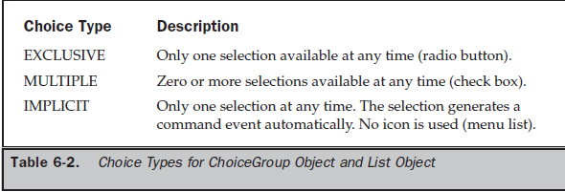

Slide 97
DateField Class
The DateField class is used to display, edit, or input date and/or time into a MIDlet.
A DateField class is instantiated by specifying a label for the field, a field mode, and a time zone, although time zone is optional. Table 6-3 lists the available DateField modes.
Both methods are illustrated in the following two statements:
DateField datefield = new DateField("Today", DateField.DATE);
DateField datefield = new DateField("Time", DateField.TIME, timeZone);
Once a DateField class is instantiated, you can use DateField class methods to enter a date and time into the date field and retrieve the date and time value that has already been entered into the date field.

Slide 99
→You place a date or time into the date field by calling the setDate() method.
→The setDate() method requires one parameter, which is an instance of the Date class containing the date/time value that will appear in the date field.
→The getDate() method is called to retrieve the date/time value of the date field.
→You can use the date/time value in a number of ways within your MIDlet, such as in a calculation.
→Besides storing and retrieving date/time values using DateField class methods, you can also replace the DateField mode and retrieve the DateField mode of an instance of a DateField class.
→The setInputMode() method replaces the existing DateField mode with the mode passed as a parameter to the setInputMode() method.
→The getInputMode() method is used to retrieve the mode of an instance of a DateField.

Slide 100
MIDlet-Name: DateToday
MIDlet-Version: 1.0
MIDlet-Vendor: MyCompany
MIDlet-Jar-URL: DateToday.jar
MIDlet-1: DateToday, , DateToday
MicroEdition-Configuration: CLDC-1.0
MicroEdition-Profile: MIDP-1.0
MIDlet-JAR-SIZE: 100
import java.util.*;
import javax.microedition.midlet.*;
import javax.microedition.lcdui.*;
public class DateToday extends MIDlet implements CommandListener
{
private Display display;
private Form form;
private Date today;
private Command exit;
private DateField datefield;
public DateToday()
{

Slide 101
display = Display.getDisplay(this);
form = new Form("Today's Date");
today = new Date(System.currentTimeMillis());
datefield = new DateField("", DateField.DATE_TIME);
datefield.setDate(today);
exit = new Command("Exit", Command.EXIT, 1);
form.append(datefield);
form.addCommand(exit);
form.setCommandListener(this);
} public void startApp ()
{display.setCurrent(form);
}public void pauseApp()
{}
public void destroyApp(boolean unconditional)
{}
public void commandAction(Command command, Displayable displayable)
{
if (command == exit)
{
destroyApp(false);
notifyDestroyed();
}
}

Slide 102
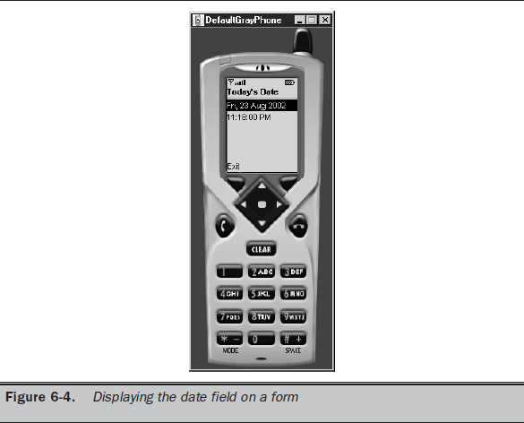

Slide 103
Gauge Class
The Gauge class creates an animated progress bar that graphically represents the status of a process.
The indicator on the gauge generated by the Gauge class moves from one end to the other Proportionally to the completion of the process measured by the gauge.
The Gauge class provides methods to display the gauge and move the indicator.
The developer must build the routine into the MIDlet to move the indicator.
This means that the routine must monitor the progress of the underlying process and move the indicator of the Gauge class to a position that corresponds to the status of the process.

Slide 104
Gauge gauge = new Gauge("Like/Dislike Gauge", true, 100, 0);
→This statement creates an interactive gauge with the caption “Like/Dislike Gauge” and a scale of zero to 100.
→The first parameter passed to the constructor of the Gauge class is a string containing the caption that is displayed with the gauge.
→The second parameter is a boolean value indicating whether or not the gauge is interactive.
→The third parameter is the maximum value of the gauge, and the last parameter is the gauge’s initial value.
→Although a gauge is set to the interactive mode, you can still change the current
value of the gauge indicator by calling the setValue() method.
→The setValue() method requires one parameter, which is the integer representing the new value.
→You must write the logic in your MIDlet to calculate the new value. Many times you will want to increment or decrement the current value of the gauge by a specific amount.
→Therefore, you’ll need to determine the current value of the gauge by calling the getValue() method.
→The getValue() method returns an integer representing the gauge’s current value.

Slide 105
Creating and Manipulating an Instance of a Gauge Class
Contains the JAD file for Listing 6-12, which shows how to create a
noninteractive gauge.
This example simulates monitoring a process and reporting the status of the process by moving the indicator on the gauge through the range
of values from zero to 100 .
The monitoring begins when the user selects the Start command. The commandAction() method then loops through moving the indicator by retrieving the current value of the indicator, incrementing that value,
and then repositioning the indicator on the gauge.
It is within this loop that you place statements that evaluate the status of a process, which is then reflected by positioning the indicator.

Slide 106
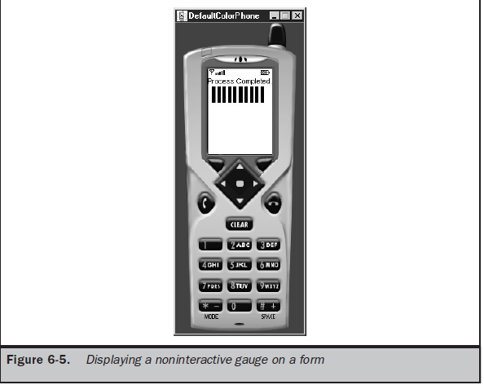

Slide 107
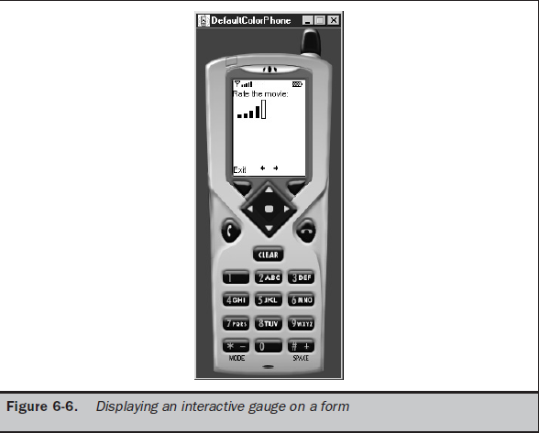

Slide 108
TextField Class
The TextField class is used to capture one line or multiple lines of text entered by the user.
The number of lines of a text field depends on the maximum size of the text field when you create an instance of the TextField class.
You instantiate the TextField class by using the following statement, passing the TextField constructor four parameters:
textfield = new TextField("First Name:", "", 30, TextField.ANY);

Slide 109
The first parameter is the label that appears when the instance is displayed on the screen.
The second parameter is text that you want to appear as the default text for the instance, which the user can edit.
The third parameter is the maximum number of characters that can be held by the instance.
You can determine the actual character size of a text box by calling the getMaxSize() method once the text field is instantiated.
Always check the maximum size of a text field before populating it if your MIDlet is likely to populate the text field with a lot of text.
In this way you can prevent an error from occurring during run time.
You can also change the maximum size by calling the setMaxSize() method.
The setMaxSize() method requires one parameter, which is the new value for the maximum size for the text field.
Any time that you need to know the length of the text in the text
field you can call the size() method, which returns an integer representing the number of characters existing in the text field.

Slide 110
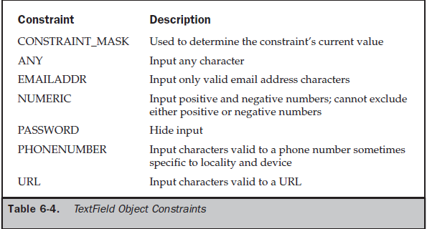
Also keep in mind that not all characters in a text field will appear on the screen.
Characters that don’t fit on the screen are still available to the user by scrolling. The
device handles scrolling for you.

Slide 111
→Three special-purpose constraints—EMAILADDR, PHONENUMBER, and URL— act as filters to assure that only valid characters can be entered into the text field for email addresses, phone numbers, and URLs.
→All other characters are treated as an error and therefore are prevented from being stored in the text field.
→The PASSWORD constraint can be combined with other constraints to hide characters from being displayed.
→An asterisk or other character determined by the device is displayed in place of the actual character placed in the text box.
→The CONSTRAINT_MASK constraint is used to determine the constraint’s current value. There are two methods you can use to retrieve characters entered into a text field by the user of your MIDlet. --→These are the getString() method and the getChars() method.
The getString() method returns the content of the text field as a string, and the getChars() method returns the text field content as a character array.
→The getChars() method requires that you pass it a character array as a parameter.

Slide 112
→You place text into a text field by calling either the setString() method or the setChars() method.
→The setString() method requires one parameter, which is the string containing text that should appear in the text field.
→The setChars() method requires three parameters.
→The first is the character array whose data will populate the text field.
→The second is the position of the first character within the array that will be placed into the text field.
→The last parameter is the length of characters of the character array that will be placed into the text field.
→ Characters in the character array will replace the entire content of the text field.

Slide 113
→You can insert characters within the text field without overwriting the entire content of the text field by calling the insert() method.
→The insert() method has two signatures, one for strings and the other for character arrays.
→The insert() method used to insert a string into the contents of a text field requires two parameters.
→The first parameter is the string that will be inserted into the text field.
→The other parameter is the character position of the current string where the new text is inserted.
→The text that exists there now will be shifted down to make room for the inserted text.
→The insert() method used to insert a character array requires four parameters.
→The first parameter is reference to the array.
→The second parameter is the position of the first character within the array that will be placed into the text field.

Slide 114
→The third parameter is the number of characters contained in the array that will be placed into the text field.
→And the last parameter is the character position of the current text that will be shifted down to make room for the inserted text.
→Text can be removed from the text field by calling the delete() method, which requires two parameters.
→The first is the position of the first character to be deleted.
→The other parameter is the length of characters that are to be deleted.
→The constraint of a text field can be changed after the instance is created by calling the setConstraints() method.
→The setConstraints() method requires you to pass the new constraint as a parameter to the setConstraints() method.
→ You can also determine the current constraint by calling the getConstraints() method.

Slide 115
Creating and Manipulating an Instance of a TextField Class
Notice that an instance of a TextField class is created within the TextCapture constructor.
This text field is labeled “First Name:” and can receive up to 30 characters of any kind. Initially, the text field is empty. Also notice that instances of two commands are created.
One command is called Submit and is selected after the user enters a first name in the text box. The other command is the Exit command and is used to terminate the MIDlet.
The form containing the text field is displayed on the screen by calling the setCurrent() method in the startApp() method .
The Submit command is detected and processed by the commandAction() method, as described in the “Item Class” section of this chapter.
If the command passed to the commandAction() method is the Submit command, the MIDlet calls the getString() method to retrieve the string from the text field.

Slide 116
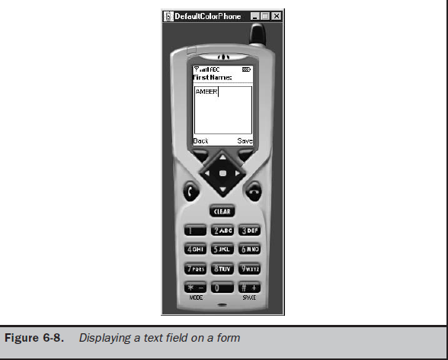

Slide 117
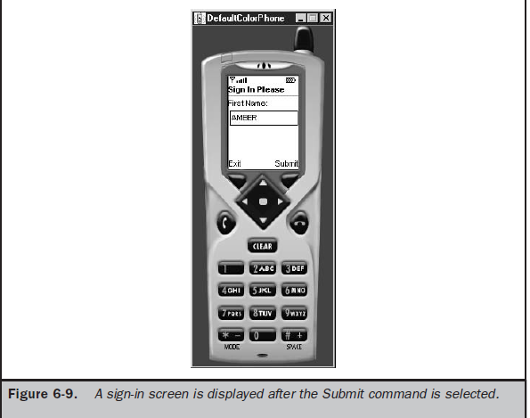
If you drop down to the commandAction() method, you’ll see that the setConstraints() method is called, changing the constraint from ANY | PASSWORD to ANY, which causes characters placed in the text field to be displayed unchanged. The MIDlet also calls the setString() method to replace the hidden content of the text field with the “Thank you.” string.

Slide 118
MIDlet-Name: TextFieldCapture
MIDlet-Version: 1.0
MIDlet-Vendor: MyCompany
MIDlet-Jar-URL: TextFieldCapture.jar
MIDlet-1: TextFieldCapture, , TextFieldCapture
MicroEdition-Configuration: CLDC-1.0
MicroEdition-Profile: MIDP-1.0
MIDlet-JAR-SIZE: 100
import javax.microedition.midlet.*;
import javax.microedition.lcdui.*;
public class TextFieldCapture extends MIDlet
implements CommandListener
{
private Display display;
private Form form;
private Command submit;
private Command exit;
private TextField textfield;
public TextFieldCapture()
{
display = Display.getDisplay(this);
submit = new Command("Submit", Command.SCREEN, 1);
exit = new Command("Exit", Command.EXIT, 1);
textfield = new TextField("First Name:", "", 30, TextField.ANY);
form = new Form("Sign In Please");

Slide 119
form.addCommand(exit);
form.addCommand(submit);
form.append(textfield);
form.setCommandListener(this);
}
public void startApp()
{
display.setCurrent(form);
}
public void pauseApp()
{
}
public void destroyApp(boolean unconditional)
{ }
public void commandAction(Command command, Displayable displayable)
{if (command == submit)
{
textfield.setString("Hello, " + textfield.getString());
form.removeCommand(submit);
}
else if (command == exit)
{
destroyApp(false);
notifyDestroyed();}}}

Slide 120
MIDlet-Name: HideText
MIDlet-Version: 1.0
MIDlet-Vendor: MyCompany
MIDlet-Jar-URL: HideText.jar
MIDlet-1: HideText, , HideText
MicroEdition-Configuration: CLDC-1.0
MicroEdition-Profile: MIDP-1.0
MIDlet-JAR-SIZE: 100
import javax.microedition.midlet.*;
import javax.microedition.lcdui.*;
public class HideText extends MIDlet implements CommandListener
{
private Display display;
private Form form;
private Command submit;
private Command exit;
private TextField textfield;
public HideText()
{
display = Display.getDisplay(this);
submit = new Command("Submit", Command.SCREEN, 1);
exit = new Command("Exit", Command.EXIT, 1);
textfield = new TextField("Password:", "", 30, TextField.ANY | TextField.PASSWORD);

Slide 121
form = new Form("Enter Password");
form.addCommand(exit);
form.addCommand(submit);
form.append(textfield);
form.setCommandListener(this);
}
public void startApp()
{
display.setCurrent(form);
}
public void pauseApp()
{
}
public void destroyApp(boolean unconditional)
{ }
public void commandAction(Command command, Displayable displayable)
{ if (command == submit)
{ textfield.setConstraints(TextField.ANY);
textfield.setString("Thank you.");
form.removeCommand(submit);
}else if (command == exit)
{
destroyApp(false);
notifyDestroyed();}}}

Slide 122
ImageItem Class
There are two types of images that can be displayed.
These are immutable images and mutable images. An immutable image is loaded from a file or other resource and cannot be modified once the image is displayed.
Icons associated with MIDlets are immutable images.
A mutable image is drawn on the screen using methods available in the Graphics class.

Slide 123
→An immutable image is drawn on a screen, and a mutable object is drawn on a canvas. As you learned at the beginning of the chapter, the Displayable class has two derived classes—the Screen class and the Canvas class.
→Immutable images are displayed using an instance of the ImageItem class, which inherits from the Item class.
→Mutable images are displayed using the Graphics class, which is derived from the Canvas class.
→The first step in displaying an immutable image is to create an instance of the Image class by calling the createImage() method.
→The createImage() method requires one parameter that contains the name of the file containing the image.
→ Make sure that you include the full path to the file in the parameter. The next step is to create an instance of the ImageItem class.

Slide 124
→The constructor of the ImageItem class requires four parameters. The first is a string that becomes the label for the image.
→The second parameter is reference to the instance of the Image class created in step one.
→The third parameter is the layout directive.
→ And the last parameter is a string referred to as alternate text that is displayed in place of the image if for some reason the image
cannot be displayed by the device.
→ Some applications won’t require you to specify a label or alternate text; therefore, use a null as the value of the parameter in place
of a string.
→The layout directive is a request to the device’s application manager to position the image at a particular location on the screen.
→The device’s application manager determines the actual location where the image appears.

Slide 125
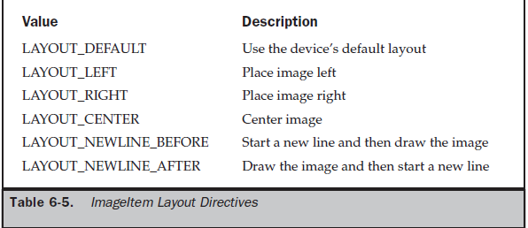
→The layout directive is a request to the device’s application manager to position the image at a particular location on the screen.
→The device’s application manager determines the actual location where the image appears.
→You can modify the image layout after the image is displayed on the screen by calling the getLayout() method and setLayout() method.
→The getLayout() method returns the current layout directive of an instance of an ImageItem.
→The setLayout() method replaces the current layout with a new layout whose directive is passed as a parameter to the setLayout() method.

Slide 126
→Likewise, you can modify the label and alternate text associated with an image by calling the getLabel() method, setLabel method, getAltText() method, and setAltText() method.
→The getLabel() and getAltText() methods retrieve the current label and alternate text, and the setLabel() and setAltText() methods are called to replace them.
→ Both the setLabel() and setAltText() methods require one parameter, which is the replacement text.
→The image itself is replaceable by calling the getImage() method and the setImage() method.
→The getImage() method fetches the current image associated with the instance of the ImageItem, and the setImage() method associates a new image with the instance.
→The setImage() method requires you to pass it an instance of an Image class.
→Therefore, you’ll need to create a new instance of the Image class for the new image before calling the setImage() method.

Slide 127
MIDlet-Name: ImmutableImage
MIDlet-Version: 1.0
MIDlet-Vendor: MyCompany
MIDlet-Jar-URL: ImmutableImage.jar
MIDlet-1: ImmutableImage, , ImmutableImage
MicroEdition-Configuration: CLDC-1.0
MicroEdition-Profile: MIDP-1.0
MIDlet-JAR-SIZE: 100
import javax.microedition.midlet.*;
import javax.microedition.lcdui.*;
public class ImmutableImage extends MIDlet
implements CommandListener
{ private Display display;
private Form form;
private Command exit;
private Image image;
private ImageItem imageItem;
public ImmutableImage()
{

Slide 128
display = Display.getDisplay(this);
exit = new Command("Exit", Command.EXIT, 1);
form = new Form("Immutable Image Example");
form.addCommand(exit);
form.setCommandListener(this);
try
{
image = Image.createImage("myimage.png");
imageItem = new ImageItem(null, image,
ImageItem.LAYOUT_NEWLINE_BEFORE |
ImageItem.LAYOUT_LEFT |
ImageItem.LAYOUT_NEWLINE_AFTER, "My Image");
form.append(imageItem);
}
catch (java.io.IOException error)
{
Alert alert = new Alert("Error", "Cannot load myimage.png.",
null, null);
alert.setTimeout(Alert.FOREVER);
alert.setType(AlertType.ERROR);
display.setCurrent(alert);

Slide 129
}
}
public void startApp()
{
display.setCurrent(form);
}
public void pauseApp()
{
}
public void destroyApp(boolean unconditional)
{
}
public void commandAction(Command command, Displayable Displayable)
{
if (command == exit)
{
destroyApp(false);
notifyDestroyed();
}
}
}

Slide 130
List Class
The List class is used to display a list of items on the screen from which the user can select one or multiple items.
There are three formats for the List class: radio buttons, check boxes, and an implicit list that does not use a radio button or check box icon.
A List class differs from the ChoiceGroup class by the way events of each instance are handled by a MIDlet.
As you recall from the discussion about the ChoiceGroup class, an ItemStateListener is used to listen to events generated by an instance of a ChoiceGroup class.
Those events are then passed along to the itemStateChanged()
method for processing. Likewise, a commandAction() method is used to process command events, as described in the “Item Class” section of this chapter.

Slide 131
→In contrast, a list does not generate an item state change event; therefore, a Command needs to be added to initiate processing.
→For example, no event is generated when a user selects a radio button or check box item with a list.
Those selections are received by the MIDlet only after an instance of a Command class is chosen.
However, a command event is automatically generated when the user selects an item from an instance of an implicit formatted List class. Typically, an implicit formatted List class is used to create a menu.
→The commandAction() method is automatically called to process the menu selection without requiring the user to select a command to process the selection.
→A List class is derived from the Screen class and does not require a container. In contrast, the ChoiceGroup class is derived from the Item class and requires an instance of a Form class to contain the instance of the ChoiceGroup class.

Slide 132
→You can create an instance of the List class with or without list items.
→ An instance is created without list items by passing the constructor of the List class two parameters.
→The first parameter is a string that contains the titles of the list, and the other parameter is the format of the list, commonly referred to as the listType.
→You can include list items when creating the instance of a List class by passing two additional parameters to the List class constructor.
→The first two parameters are title and listType.
→The third parameter is a string array whose elements contain list items that can be selected by the user of your MIDlet.
→The fourth parameter is an array of instances of the Image class, each associated with a corresponding list item.

Slide 133
→List items can be added to an instance of a List object by calling the append() method or insert() method.
→The append() method requires two parameters.
→The first parameter is the string that contains the new list item, and the second parameter is an instance of the Image class of an image that is associated with the new list item.
→The new list item is appended to the end of the list.
→The insert() method is very similar in design to the append() method, except the
new list item is inserted within the list.
→Three parameters are necessary for the insert() method.
→ The first parameter is the index number of the list item above which the new
list item is inserted. The other two parameters are the same as the parameters of the append() method.
→You can retrieve the list item selected by the user by calling the getSelectedIndex() method.
→The getSelectedIndex() method returns the index number of the selected
list item.
→ You pass the returned index number as the parameter to the getString()
method, which returns the string of the selected list item, which is then processed
by the commandAction() method.

Slide 134
Creating an Instance of a List Class

Slide 135
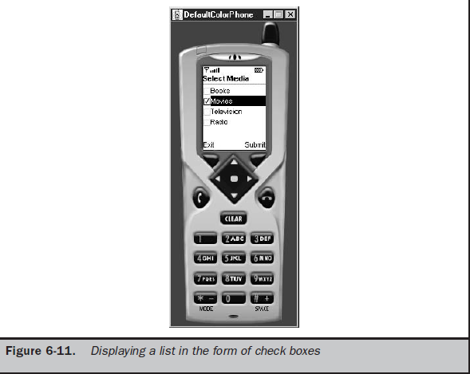

Slide 136
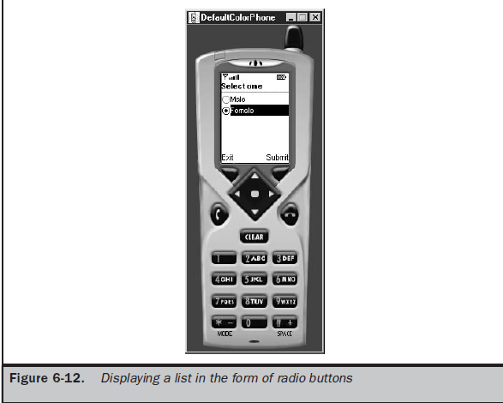

Slide 137
TextBox Class
The TextBox class is very similar to a TextField class, discussed previously in this chapter.
Both are used to receive multiple lines of textual data from a user and constrain text that can be entered using the constraint directives You can request that a maximum number of characters be allowed in instances of both the TextBox class and the
TextField class.
However, the device determines the actual size of both of these instances. Characters that exceed the display area of the screen become scrollable in many devices.
The TextBox class and TextField class differ in that the TextBox class is derived from the Screen class, while the TextField class is derived from the Item class. This means that an instance of the Form class cannot contain an instance of the TextBox class, while
an instance of a TextField class must be contained within an instance of the Form class.

Slide 138
→Another important difference between the TextBox class and the TextField class is that the TextBox class uses a CommandListener and cannot use an ItemStateListener.
→An ItemStateListener is used with an instance of the TextField class, although many times the content of an instance of the TextField class is retrieved and processed when the user selects a command associated with a form that contains the text field.
→An instance of the TextBox class is created by passing four parameters to the TextBox class constructor.
The first parameter is the title of the text box.
The second parameter is text used to populate the instance.
The third parameter is the maximum number of characters that can be entered into the instance.
Keep in mind that this parameter is a request and may not be fulfilled by the device. The device determines the maximum
number of characters for an instance of the TextBox class. The last parameter is the constraint used to limit the types of characters that can be placed within the instance.

Slide 139
Creating an Instance of a TextBox Class
Many of the keys on a telephone keypad are associated with three letters. Select each letter associated with a key by pressing the key multiple times.
For example, the letter I is the third letter associated with key 4. You can display the letter I on the screen by
pressing the key three times.
When the Submit command is selected, it is processed by the commandAction() method (see “Item Class,” earlier in this chapter).
The name is copied from the text box and used to form a greeting, which then replaces the first name on the screen.

Slide 140
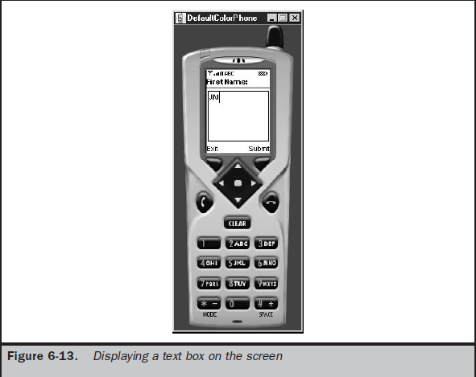

Slide 141
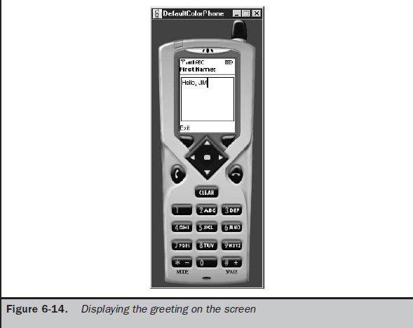

Slide 142
Ticker Class
The Ticker class is used to scroll text horizontally on the screen much like a stock ticker scrolls stock prices across the screen.
An instance of the Ticker class can be associated with any class derived from the Screen class and be shared among screens.
An instance of a Ticker object is created by passing the constructor of the Ticker class a string containing the text that is to be scrolled across the screen.
You cannot control the location on the screen where scrolling occurs. Likewise, there is no control over the speed of the scrolling.
The device that runs the MIDlet controls both location and speed.
You can retrieve the text associated with an instance of the Ticker class by calling the getString() method. You can replace the text currently scrolling across the screen by calling the setString() method. The setString() method requires one parameter, which
is a string containing the replacement text.

Slide 143
This example creates a set of radio buttons that contain two options (Figure 6-15). The
first option is called “Technology” and the other “Entertainment.” When the MIDlet
runs, fictitious stock symbols and stock prices representing the technology industry
scroll across the screen. The user is prompted to select a radio button, then select the
Submit command. The Submit command causes the MIDlet to display the desired
industry stock symbols and prices scrolling across the ticker.

